Slide 1
Statement of the Situation
Robinson School Data
PFAS Compound | Result
Perfluorooctanoic Acid (PFOA) | 8-9 ng/L
Perfluorooctanesulfonic Acid (PFOS) | 58-101 ng/L
Perfluorobutanesulfonic Acid (PFBS) | 14-39 ng/L
Perfluorohexanesulfonic Acid (PFHxS) | 20-32 ng/L
Perfluorohexanoic Acid (PFHxA) | 3 ng/L
Proposed Michigan
Drinking Water Standards
• PFOA: 8-ppt
• PFOS: 16-ppt
• PFBS: 420-ppt
• PFHxS: 51-ppt
• PFHxA: 400,000-ppt
• PFNA: 6-ppt
• GenX: 370-ppt
USEPA Health Advisory Limit: 70 ppt PFOA + PFOS

Slide 2
Ion Exchange Advantages
Ion exchange operates longer until breakthrough compared to GAC for a similar volume (less frequent change-outs)
Ion exchange usually needs shorter contact time between media and water compared to GAC
Ion exchange takes a smaller footprint than GAC
Ion exchange is effective for a wider range of PFAS compared to GAC
Notes:
IX resin tends to cost 3-5x more than GAC per unit volume, but requires fewer vessels – may end up being more economical

Slide 3
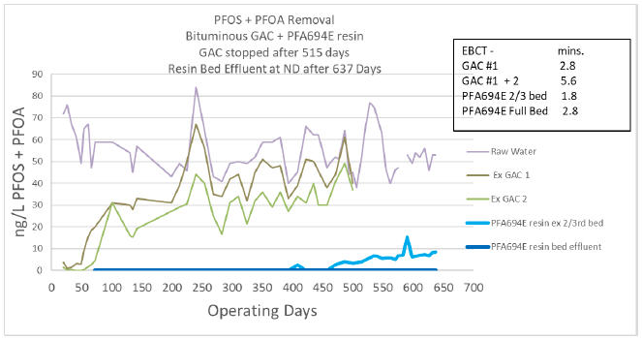
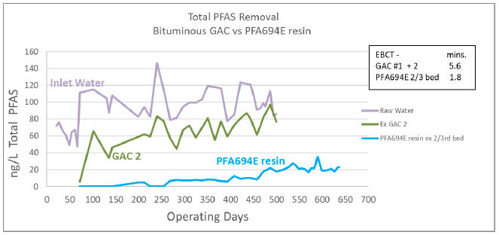
GAC vs Ion Exchange
Ion exchange operates longer than GAC for a similar volume
Note: Graphs provided by Purolite
Notes:
https://www.bioprocessonline.com/doc/pilot-study-ion-exchange-and-gac-to-reduce-pfas-to-non-detect-0001

Slide 4
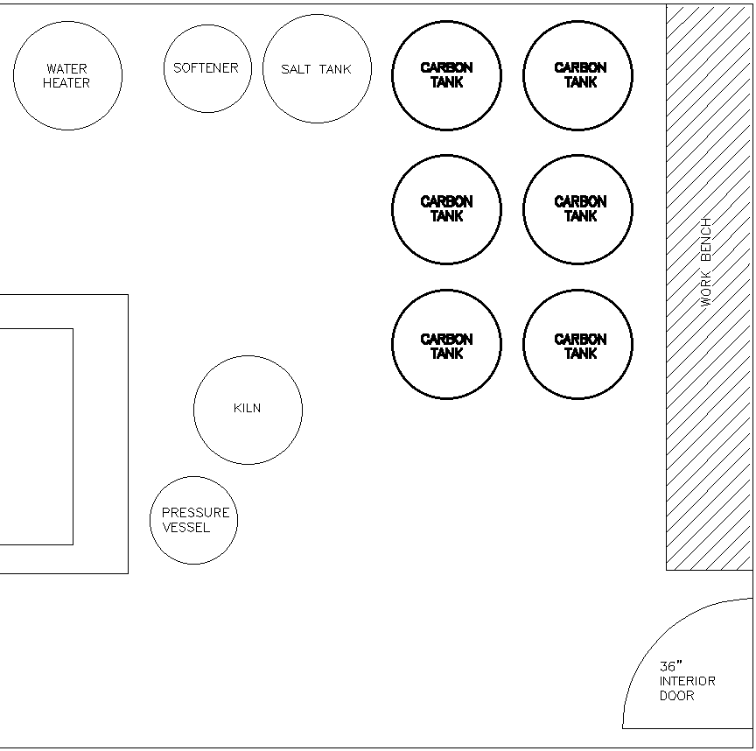
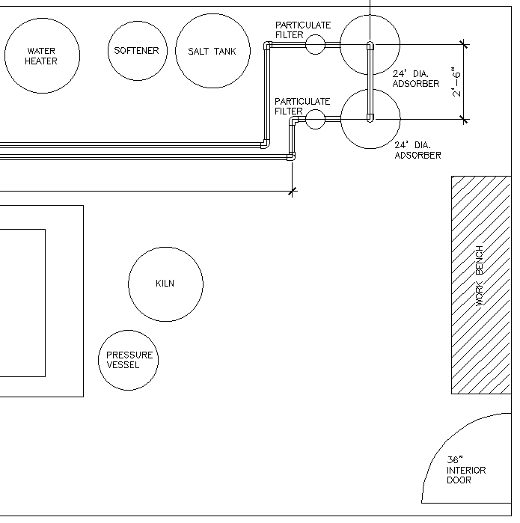
GAC vs Ion Exchange

Slide 5
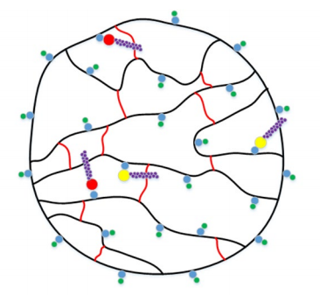
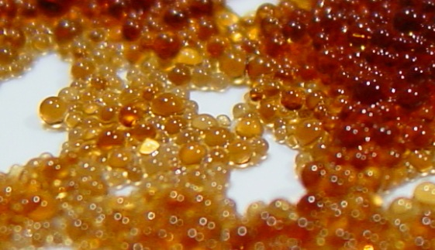
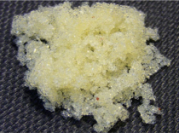
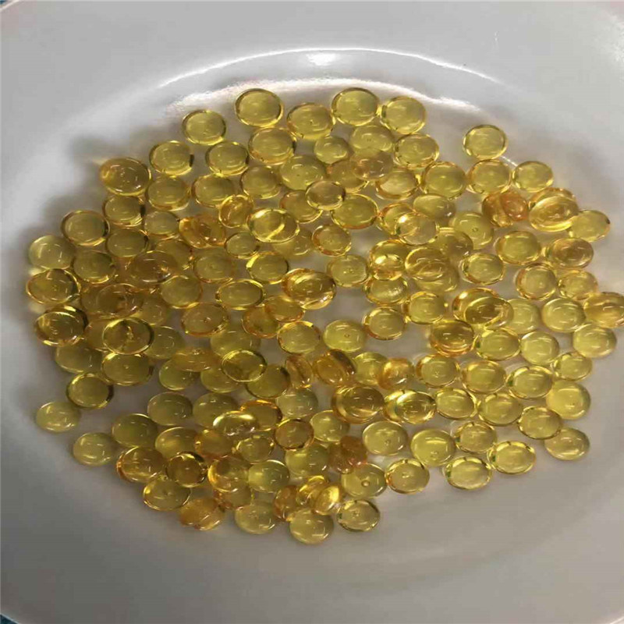
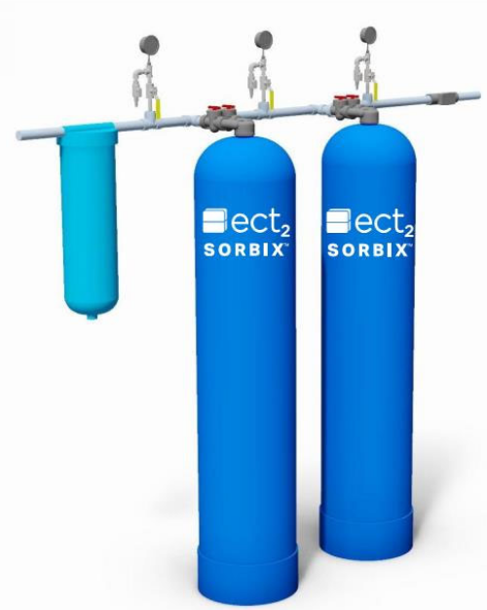
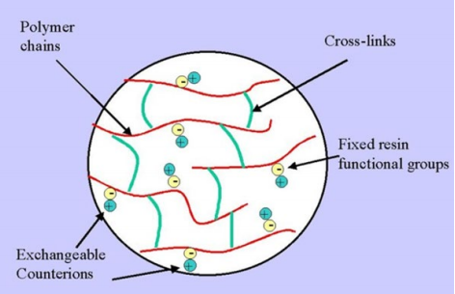
Ion Exchange Overview
Resin (Beads)
PFAS
Simplified Resin Bead
Treating PFAS
Treatment Vessels
Simplified Resin bead

Slide 6
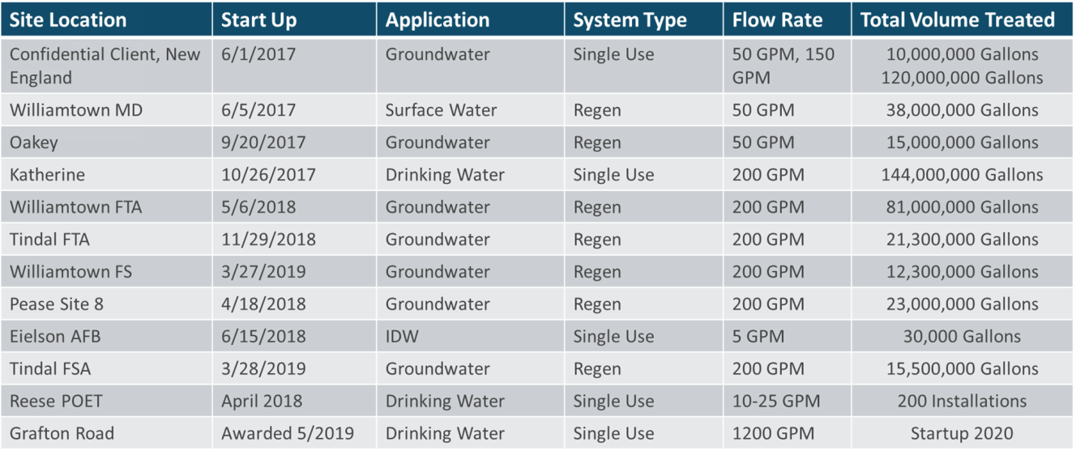
Ion Exchange Overview
Note: Information provided by ECT2

Slide 7
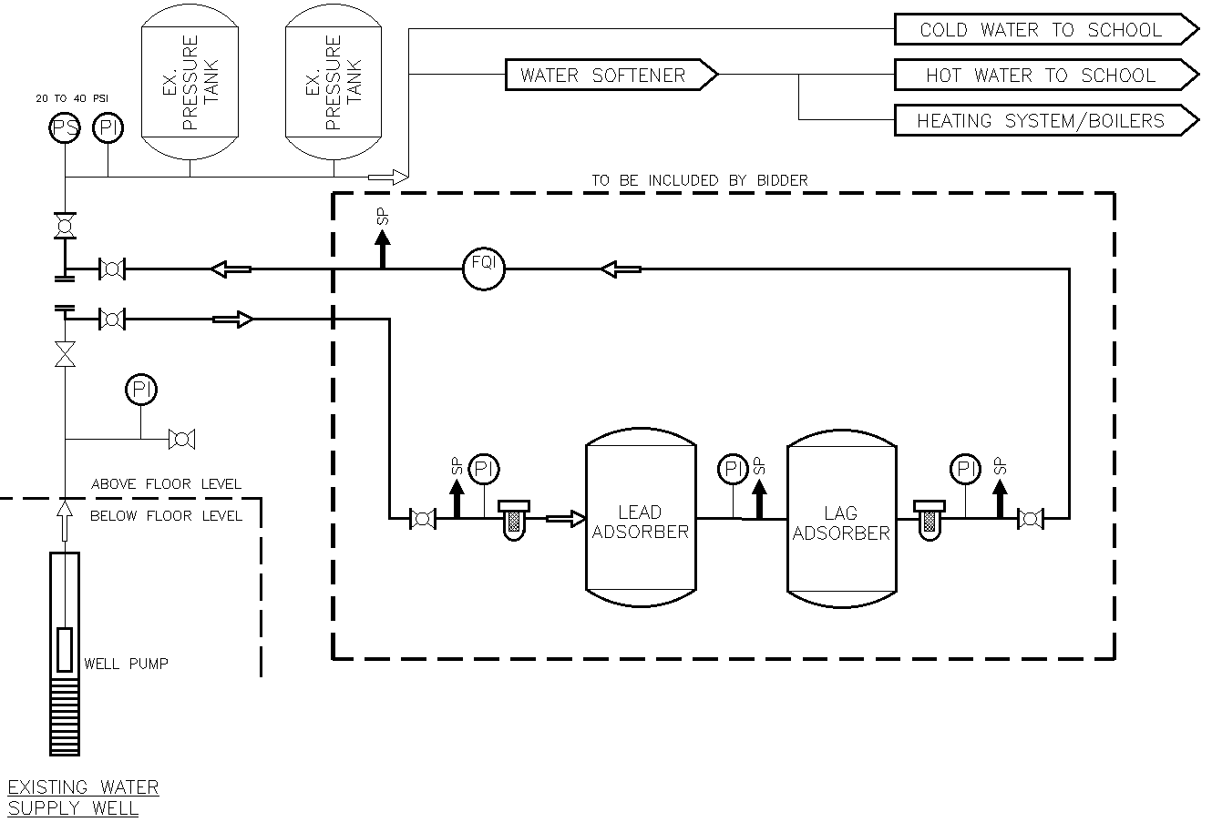
(design GAC & IX)
Design basis: Reduce Identified PFAS Constituents below 5 ppt for at least 12 months
Calculated Media Life: 32 months
Fishbeck

