Slide 1
August 8, 2019
Steaders Borough South Drain Board of Determination

Slide 2
Steaders Borough South Drain
The existing storm water drain system was established as a county drain on December 12, 2017.
Petitioned by (5+) freeholders within the district on June 19, 2019 under Chapter 8 of the Michigan Drain Code of 1956.
Michigan Drain Code requires a Board of Determination Meeting

Slide 3
Steaders Borough South Drain
1 plat is a part of the Steaders Borough South Drain:
Steaders Borough No. 2 – (1989)

Slide 4
Current Drainage District and Route and Course

Slide 5
Current Drainage District and Route and Course

Slide 6
Ponding issues occurred between River Bluff Court and Steaders Pass during the Spring of 2019

Slide 7
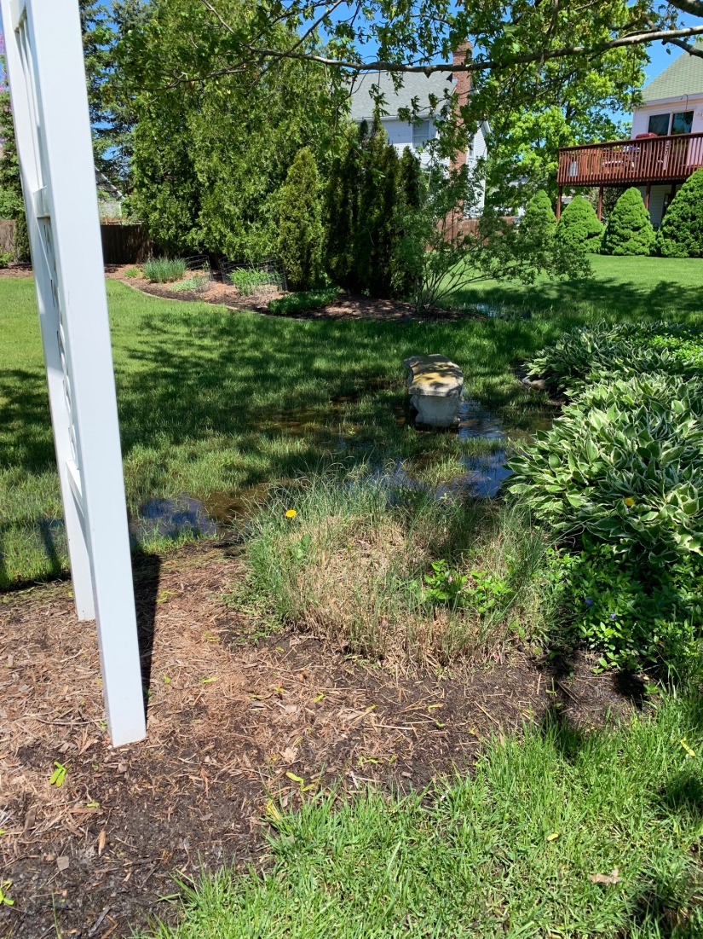
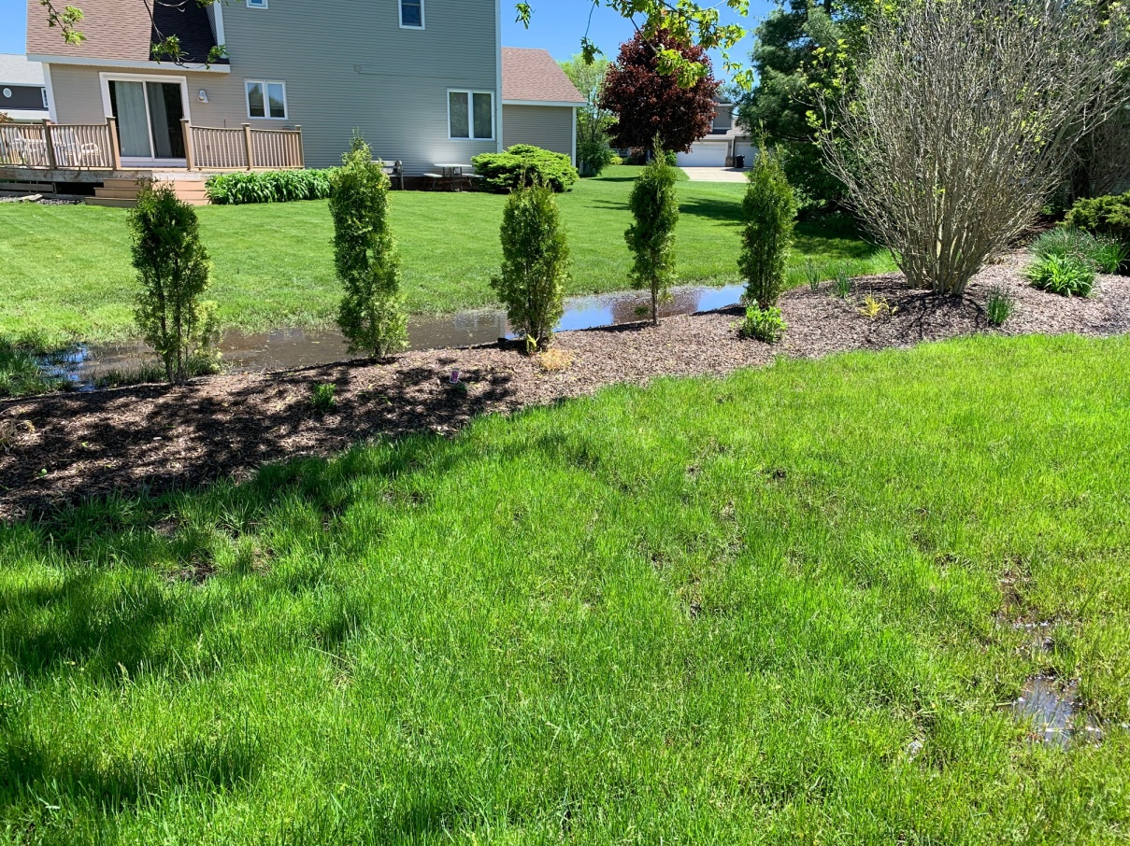
In backyard of 1296 River Bluff Court looking north at backyard of 1341 Steader’s Pass
In backyard of 1296 River Bluff Court looking northeast at backyard of 1323 Steader’s Pass
Photos of Ponding Taken on 5/23/2019 near 1296 River Bluff Court

Slide 8
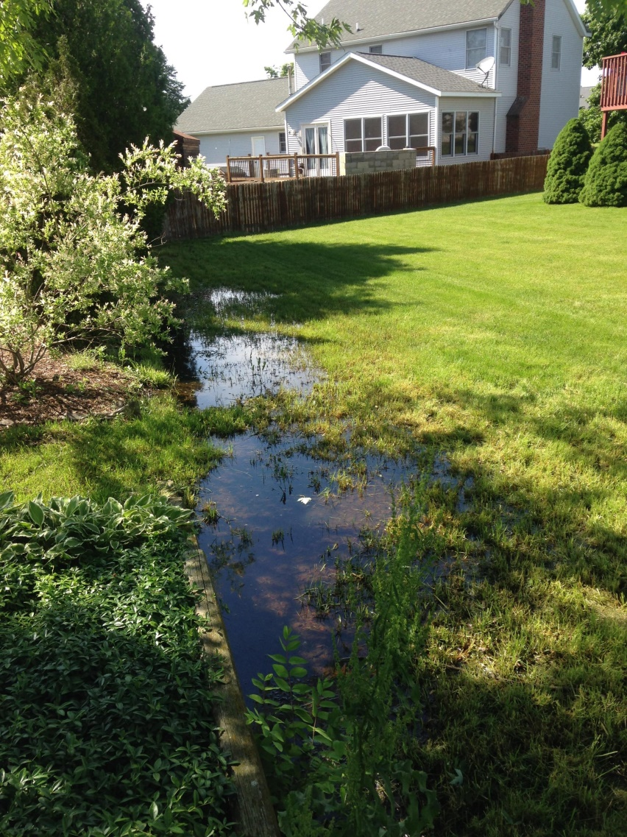
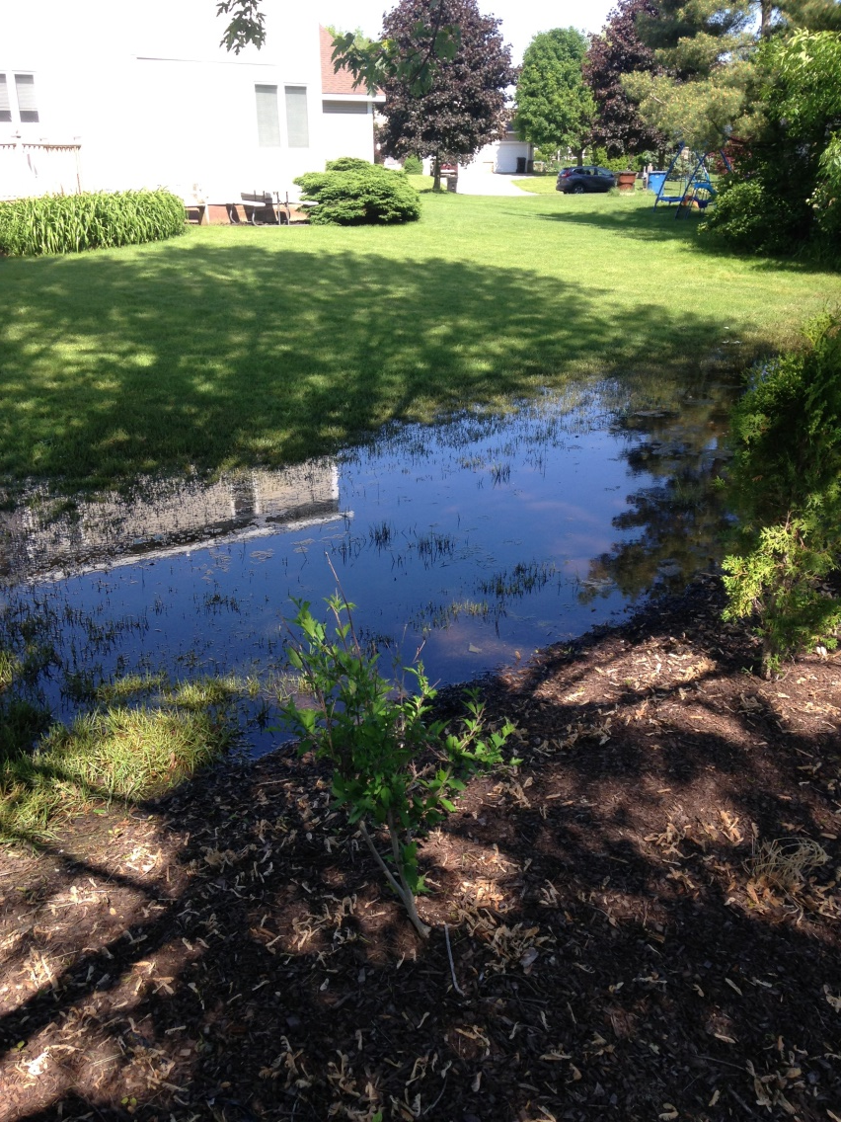
In backyard of 1296 River Bluff Court looking northeast at backyard of 1323 Steader’s Pass
In backyard of 1341 Steader’s Pass looking northwest at backyard of 1357 Steader’s Pass
Photos of Ponding Taken by Property Owner near 1296 River Bluff Court

Slide 9
Other ponding issues were identified in 2018

Slide 10
Photos of Ponding Taken on 2/20/2018 in the backyard of 1294 Steaders Pass looking south

Slide 11
Photos of Ponding Taken on 2/20/2018 in the backyard of 1242 Steaders Pass looking north

Slide 12
Steaders Borough South Drain
Board of Determination to hear public and municipal comments about the petition
Next Steps:
If a petition is deemed necessary:
Project Design
Easement Acquisition
Project Bid and Construction
Day of Review
If petition is deemed not necessary:
No further action will occur

